Slide 1


托福听力7
金牌听力名师
大菁儿老师
2021.6.15

Slide 2
第六节课回顾： 十大考点——对比+分类； 生命科学词汇串讲 生态学+动物学文章及菁讲精练

Slide 3
十大考点——因果+转折；
文化艺术词汇串讲及菁讲精练

Slide 4
考点七：记因果
细节题，其实就是考原因，找不到答案，回笔记找R就是原因！
原因： because ，because of ，due to ，since ，as ，for，The reason is ，That’s why，By reason of ， Owing to
结果：so ，so that ，therefore ，thereby ，hereby ，thus ，As a result ，consequently ，hence ，accordingly

Slide 5
因果题练习1
TPO24-L3 巨型动物 1'59;3'12-3'31
alternative
seasonality
moderate
extreme shift
plant diversity

Slide 6
TPO24-3
4.According to the climate change theory, how did the climate change at the end of the ice age make it more difficult for large animals to survive?
[Click on 2 answers.]
A. By reducing the size of their habitats
B. By forcing them to endure a wider range of temperatures
C. By reducing the variety of food available to them
D. By forcing them to live near humans

Slide 7
练习
These extreme shifts would have put a lot of stress on the bodies of animals that were used to a more moderate range of temperatures.
(B) And as a result, uh, so the theory goes, the Ice Age animals that depended on plant diversity couldn't survive.（C)

Slide 8
考点八：记转折
遇到but不能放，托福听力也是一样
信号词：
But, however, nevertheless, while, yet, unless, except for, actually, in fact, to tell you the truth，practically, virtually, as a matter of fact

Slide 9
转折练习1
TPO6-L1 boom and bust 1'14-1'30
hail from 出生于
Celestial Mountain昆仑山脉

Slide 10
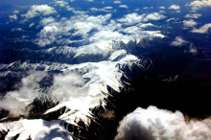
Student : Well, the Netherlands, right?
Professor : That’s what most people think, but no. They are not native to the Netherlands, or even Europe. Tulips actually hail from an area that Chinese call the Celestial Mountains in Central Asia.

Slide 11
3.According to the professor,where did tulips originate?
A. the mountains of central Asia.
B. the region around Istanbul in Turkey.
C. the sandy soils of the Netherlands.
D. the forests of northern Europe.

Slide 12
转折练习2
TPO4-L4 政府支持艺术 4'17
government funding
for and against

Slide 13
in fact, with artists in particular, you have lots of artists who support—and who have benefit from—this agency, al–although it seems that just as many artists oppose a government agency being involved in the arts for many different reasons—reasons like they don't want the government to control what they create. In other words... the arguments both for and against government funding of the arts are as many and, and as varied as the individual styles of the artists who hold them.

Slide 14
5.What does the professor say about artists’ opinions of government support for the arts?
A. Most artists believe that the government should provide more funding for the art.
B. Most artists approve of the ways in which the government supports the arts.
C. Even artists do not agree on whether the government should support the arts.
D. Even artists have a low opinion of government support for the arts.

Slide 15
转折练习3
TPO17-L4 octopus 3'33-4'22
mimic
texture
resemble
papillae
flatten out

Slide 16
note:
× color, 也 texture
小pro---不同texture “ppl”
rough----raise
smooth---flatten(blend in env)
swim × see
But they don’t just mimic the colors in their environment; they can also mimic the texture of objects in their environment. They have these little projections on their skin that allow them to resemble various textures. The projections are called papillae. If the octopus wants to have a rough texture, it raises the papillae. If it wants to have a smooth texture, it flattens out the papillae, so it can acquire a smooth texture to blend in with the sandy bottom of the sea. So the octopus has the ability to mimic both the color and the texture of its environment. And it’s truly amazing how well it can blend in with its surroundings. You can easily swim within a few feet of an octopus and never see it.

Slide 17
4.What does the professor say about the function of the papillae?
A. They produce dye in different colors.
B. They propel the octopus through the water.
C. They change the texture of the octopus’ skin.
D. They help the octopus contract into a smaller shape.

Slide 18
art history 场景词汇
intangible [ɪnˈtændʒəbəl] adj.无形的，触不到的
private collection ['praɪvət] [kə'lɛkʃən] 私人收藏
renowned [rɪˈnaʊnd] adj.享有声誉的，有名望的
authentic [ɔ'θɛntɪk] adj.真正的，真实的；可信的
authorship ['ɔθɚ'ʃɪp] n.（书等的）原创作者，来源；作者的身份
individualism [,ɪndɪ'vɪdʒuəlɪzəm] n.个人主义；利己主义
commission [kə'mɪʃən] n.佣金；委托；v.委托制作
tendency ['tɛndənsi] n.倾向，趋势；癖好
secular ['sɛkjəlɚ] adj.世俗的；长期的；现世的；不朽的；n. 修
道院外的教士，(对宗教家而言的) 俗人
visualize ['vɪʒuəlaɪz] vt.形象，形象化；想像，设想；vi. 显现
three-dimensional - ['dɪ'menʃənəl] adj.三维的；立体的
resin ['rezin] n.树脂；松香
disintegrate [dɪsˈɪntɪˌɡret] v.碎裂，崩裂; 瓦解，分崩离析;
divinity [dɪˈvɪnɪti] n.神; 神学; 神圣，尽善尽美;
replicate ['rɛplɪket] v.复制；n.复制品
vintage ['vɪntɪdʒ] adj.老式的；n.古董，（某地某年产的）产品

Slide 19
art history场景词汇
art conservation - [,kɑnsɚ'veʃən] 艺术保护
cave art - 洞窟美术
masterpiece ['mæstəpis] n.杰作
aesthetic [ɛs'θɛtɪk] adj.美学的
school [skul] n.学派
patron ['petrən] n.赞助人
curator [kjʊ'retɚ] n.馆长
scribe [skraɪb] n.抄写员; v.写下，记下
virtuoso [,və:tju'əuzəu] n.艺术大师
master ['mæstɚ] n.大师
precursor [pri'kɝsɚ] n.先驱者；前辈
pioneer [,paɪə'nɪr] n.先驱者；先锋；倡导者；创始人
critic ['krɪtɪk] n.批评家，评论家
apprentice [ə'prɛntɪs] n.学徒
Renaissance ['rɛnəsɑns] n.文艺复兴

Slide 20
music 场景词汇
romantic style - n.浪漫主义
classical music ['klæsɪk(ə)l] ['mjuzɪk] 古典音乐
avant-garde music [,ævɔŋ'ɡɑ:d] - 先锋派音乐
folk music - n.乡村音乐
blues [blu:z] n.蓝调
musical ['mjuzɪkl] n.音乐剧；adj.音乐的
opera ['ɑprə] n.歌剧
composer [kəm'pozɚ] n.作曲家
composition [,kɑmpə'zɪʃən] n.作曲；作品
conventional [kənˈvenʃənl] adj.传统的；习用的
enamored [ɪ'næməd] adj.倾心的，被迷住的
grandeur ['ɡrændʒə] n.宏伟壮丽感
hollow [ˈhɒlo] adj.空的；空洞的
improvise [ˈɪmprəvaɪz] v.即兴创作
lyrical ['lɪrɪkl] adj.抒情的
melodious [mə'lodɪəs] adj.旋律优美的
melody ['mɛlədi] n.旋律；美妙的音乐
rhythm [ˈrɪðəm] n.节奏，韵律

Slide 21
music 场景词汇
tone [ton] n.音色；色调；语气
note [not] n.音符
pitch [pɪtʃ] n.音高
orchestra ['ɔrkɪstrə] n.管弦乐队
piece [pis] n.作品
lyrics ['lɪrɪks] n.歌词
soundtrack [ˈsaʊndˌtræk] n.声道，声带
anechoic chamber [ˌænɛˈkoɪk ˈtʃembɚ] 消声室
aria ['ɑrɪə] n.咏叹调
recitative [,rɛsɪtə'tiv] n.宣叙调
chanting ['tʃɑ:ntɪŋ] n.吟诵，咏唱
theme [θim] n.主题；主旋律
movement ['muvmənt] n.乐章
register ['rɛdʒɪstɚ] n. 声区 音区

Slide 22
art 精讲精练：
TPO8-lecture4 巴黎女性艺术家发展史
canny businessman 精明的
premier(premiere)
trial
progressive
formal setting
criticism
sculpture
approval

Slide 23
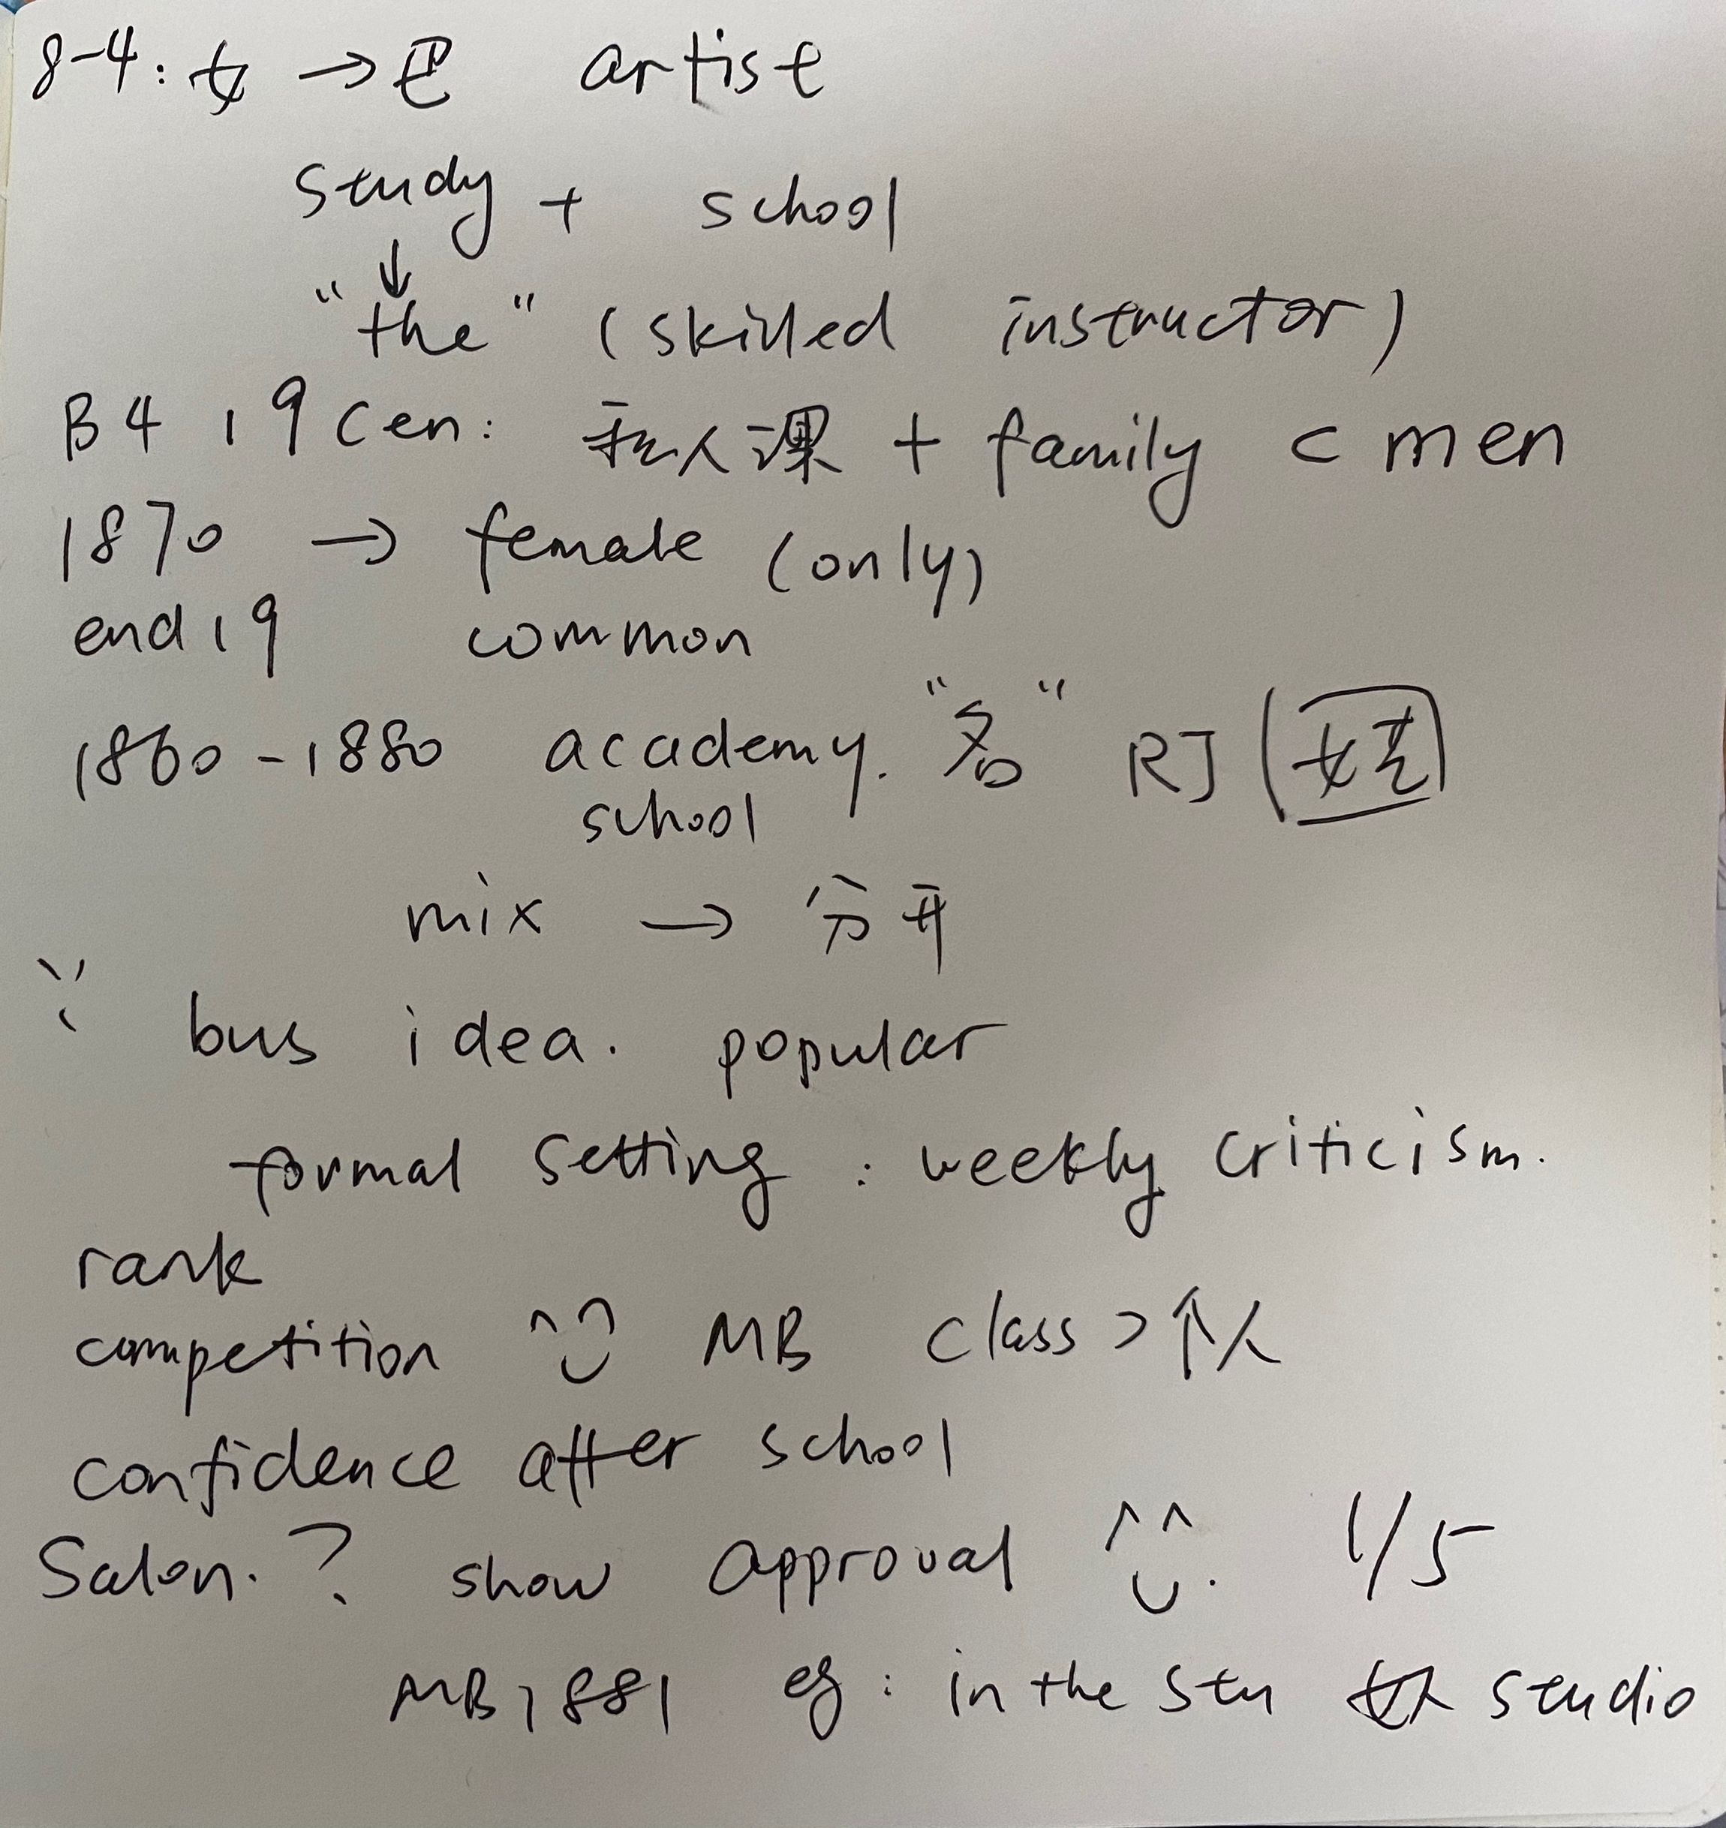
TPO8-lecture4
笔记

Slide 24
TPO8-lecture4
1.What is the lecture mainly about?
A.Why the Salon exhibitions became popular among women artists in Paris
B.Why French society did not approve of art schools or women
C.How opportunities for women artists in Paris improved
D.How women artists in Paris cooperated with one another

Slide 25
TPO8-lecture4
2.What point does the professor make about Julian when he mentions that Julian’s art school offered some classes only for women?
A.Julian’s school was the first art school in Paris to offer women-only classes
B.Julian wanted to encourage the distinctive style of women in Paris
C.Julian viewed himself as a social reformer
D.Julian possessed outstanding business skills

Slide 26
TPO8-lecture4
3.What does the professor emphasize as one benefit of competition in women’s classes?
A.Women gained more confidence in their artistic abilities
B.Women became instructors in private art studios
C.Women were able to sell their paintings for large amounts of money
D.Women created new styles of painting

Slide 27
TPO8-lecture4
4.According to the professor, what were two ways that the situation of women artists had changed by then end of the nineteenth century in Paris?
Click on 2 answers.
A.Women and men took art classes together
B.Women artists played a greater role in the Salon exhibitions
C.More schools were established by women artists
D.Fewer women artists were traveling to Paris

Slide 28
TPO8-lecture4
5.What does the professor imply about Bashkirtseff’s painting In the Studio?
A.It was one of many paintings that depicted a women’s studio
B.It did not bring Bashkirtseff recognition for her artistic ability
C.It was criticized for an unrealistic depiction of women artists
D.It was beneficial for both Bashkirtseff and the school where she studied

Slide 29
TPO8-lecture4
6.Listening again to part of the conversation. Then answer the question.
What does the professor mean when he says this?
A.Paris was a popular place to visit, but not the best place to study art
B.Paris was the most important place for an artist to study and work
C.Living in Paris was difficult for women artists from other countries
D.Studying in Paris was beneficial for some artists, but not for others.

Slide 30
练习：
TPO17-lecture1 史前年代测定方法
prehistoric art
Upper Paleolithic period
portable work
ivory
mammoth tusk
stratigraphy(strata/stratum)
radiocarbon dating
charcoal
preconceived 先入为主
sophisticated artist
primitive style
straight line
analogy

Slide 31
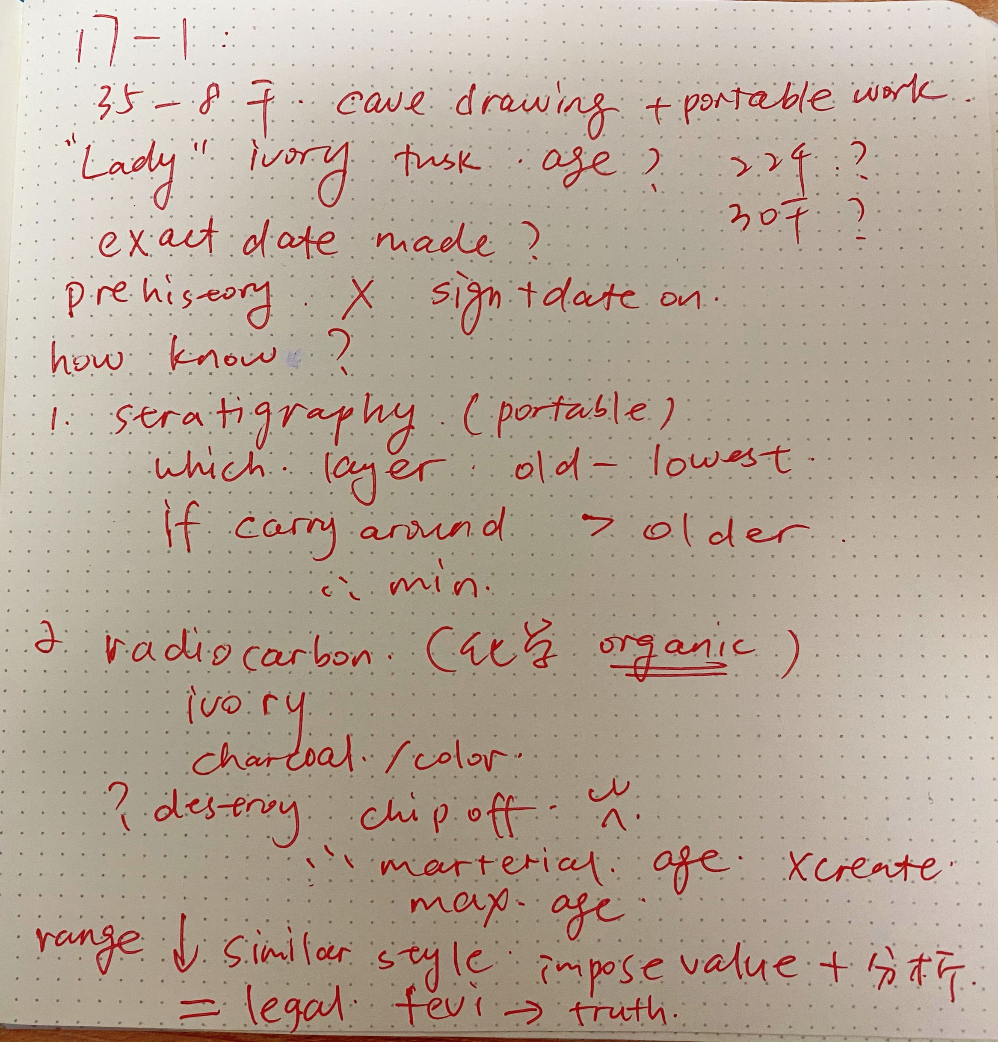
TPO17-lecture1
笔记

Slide 32
TPO17-lecture 1
1.What is the talk mainly about?
A.Techniques for locating archaeological sites.
B.Methods of preserving archaeological sites.
C.Limitations of some techniques for dating artifacts.
D.Difficulties in determining where artifacts were created.

Slide 33
TPO17-lecture 1
2.According to the professor, when might stratigraphy provide misleading information about a portable object?
A.When the object has decomposed over time.
B.When the object is older than the site at which it was found.
C.When the object is found in the lowest soil layer of a site.
D.When the object was broken during excavation.

Slide 34
TPO17-lecture 1
3.What are two disadvantages of radiocarbon dating? Click on 2 answers
A.It cannot be used for dating art made of organic material.
B.It causes damage to the material being analyzed.
C.It can be used for dating only portable art.
D.It cannot prove when a piece of art was made.

Slide 35
TPO17-lecture 1
4.What is the professor’s opinion about the practice of dating a piece of art by analyzing its artistic style?
A.It provides the strongest type of dating evidence.
B.It is more useful for some types of art than others.
C.Use of the practice has improved over the last century.
D.Some analysts make questionable assumption when using it.

Slide 36
TPO17-lecture 1
5.How does the woman summarize the professor’s main point in the talk?
A.By drawing a parallel with a process common to the legal field.
B.By repeating a comment the professor made at the beginning of class.
C.By referring to a study that supports the professor’s theory.
D.By comparing the professor’s remarks with statements in the textbook.

Slide 37
TPO17-lecture 1
6.Why does the professor say this?
A.To make the point that written records are not important.
B.To explain why the question is worth discussing.
C.To justify the omission of an important point.
D.To express his opinion about the quality of prehistoric art.

Slide 38
课后作业：
1. 回顾本次课内容，art history +music单词记忆内容
2. 完成TPO21-4；22-4；23-4；
34-1；35-3；40-1的所有lecture题目
3. 预习第8次课中植物学+环境科学词汇
题目群里打卡

Slide 39

【✨课程福利✨】
1. 微博打卡：#考虫托福系统班#+天数+收获+图片+@考虫托福 @相应科目的老师 @酵母菁
（1）每周一抽取2个上周连续打卡的虫子送抱枕
2. 听课评论，听课后点击右上角【评论】按钮，说说虫子们对课程的想法和感受，课程结束后抽2个考虫T恤喔！

Slide 40
综合练习：
TPO51-C2
reception 招待会
modest 谦虚
approve the funding 批准经费
freight 货运

Slide 41
综合练习：
TPO51-C2
1.Why does the student go to see the woman?
A. To ask her for help with organizing an event
B. To invite her to a reception at an art gallery
C. To request additional funds for a student activity
D. To suggest a last-minute change in plans for a trip

Slide 42
综合练习：
TPO51-C2
2.What point does the student make about his job in the Student Activities Center?
A. He found out about the art exhibit from someone he works with.
B. His roommate helped him to get the job.
C. The job typically involves organizing trips to New York City.
D. The activities that the center organizes are popular.

Slide 43
综合练习：
TPO51-C2
3.What two points does the student make about the history of the High Line?
[Click on 2 answers.]
A. The High Line once was part of a train line that transported freight
B. The High Line originally was built as a park for outdoor art exhibits.
C. The High Line has long been a popular destination for tourists to New York City.
D. The High Line was not used for many years.

Slide 44
综合练习：
TPO51-C2
4.Why does the woman mention the information in the poster?
A. To point out that the tour leader's name was not listed
B. To point out a problem with the student's suggestion about walking to the gallery
C. To explain why so few students signed up for the trip
D. To explain why the bus would not be available for taking the students on the trip

Slide 45
综合练习：
TPO51-C2
5.What does the woman imply when she says this:
A. She has already seen the art exhibit.
B. She would be willing to go on the trip.
C. She prefers walking to taking the bus in New York.
D. She is surprised that she has not heard of the High Line.

Slide 46
End

